Slide 1
Do you know your breeds?
Dog/Cat Breed Quiz

Slide 2
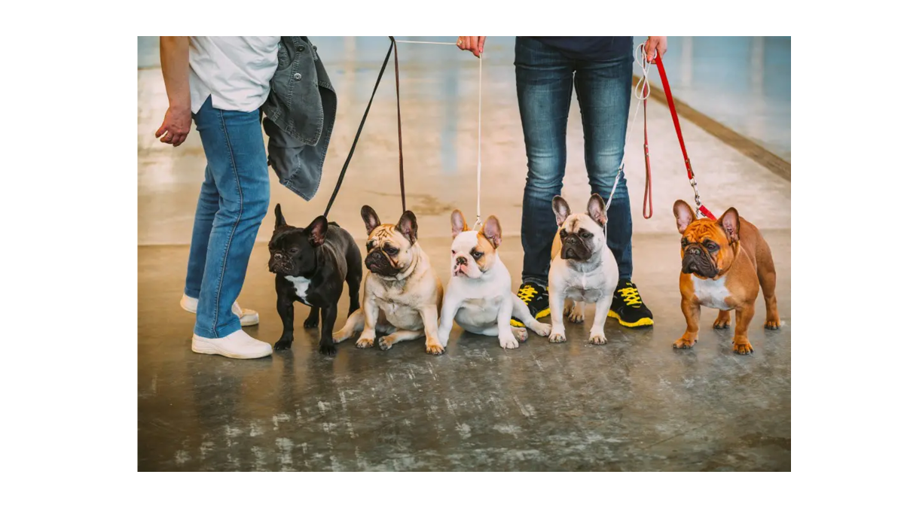
Notes:
French Bulldog

Slide 3
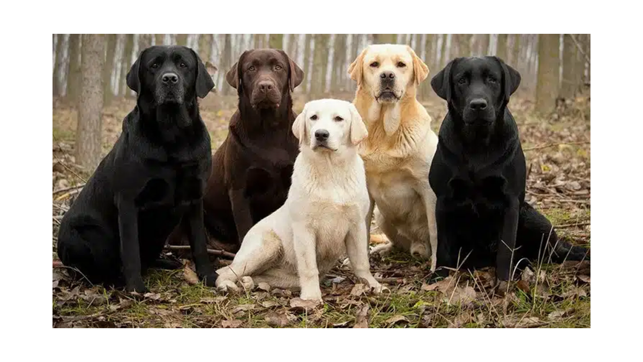
Notes:
Labrador Retrievers

Slide 4
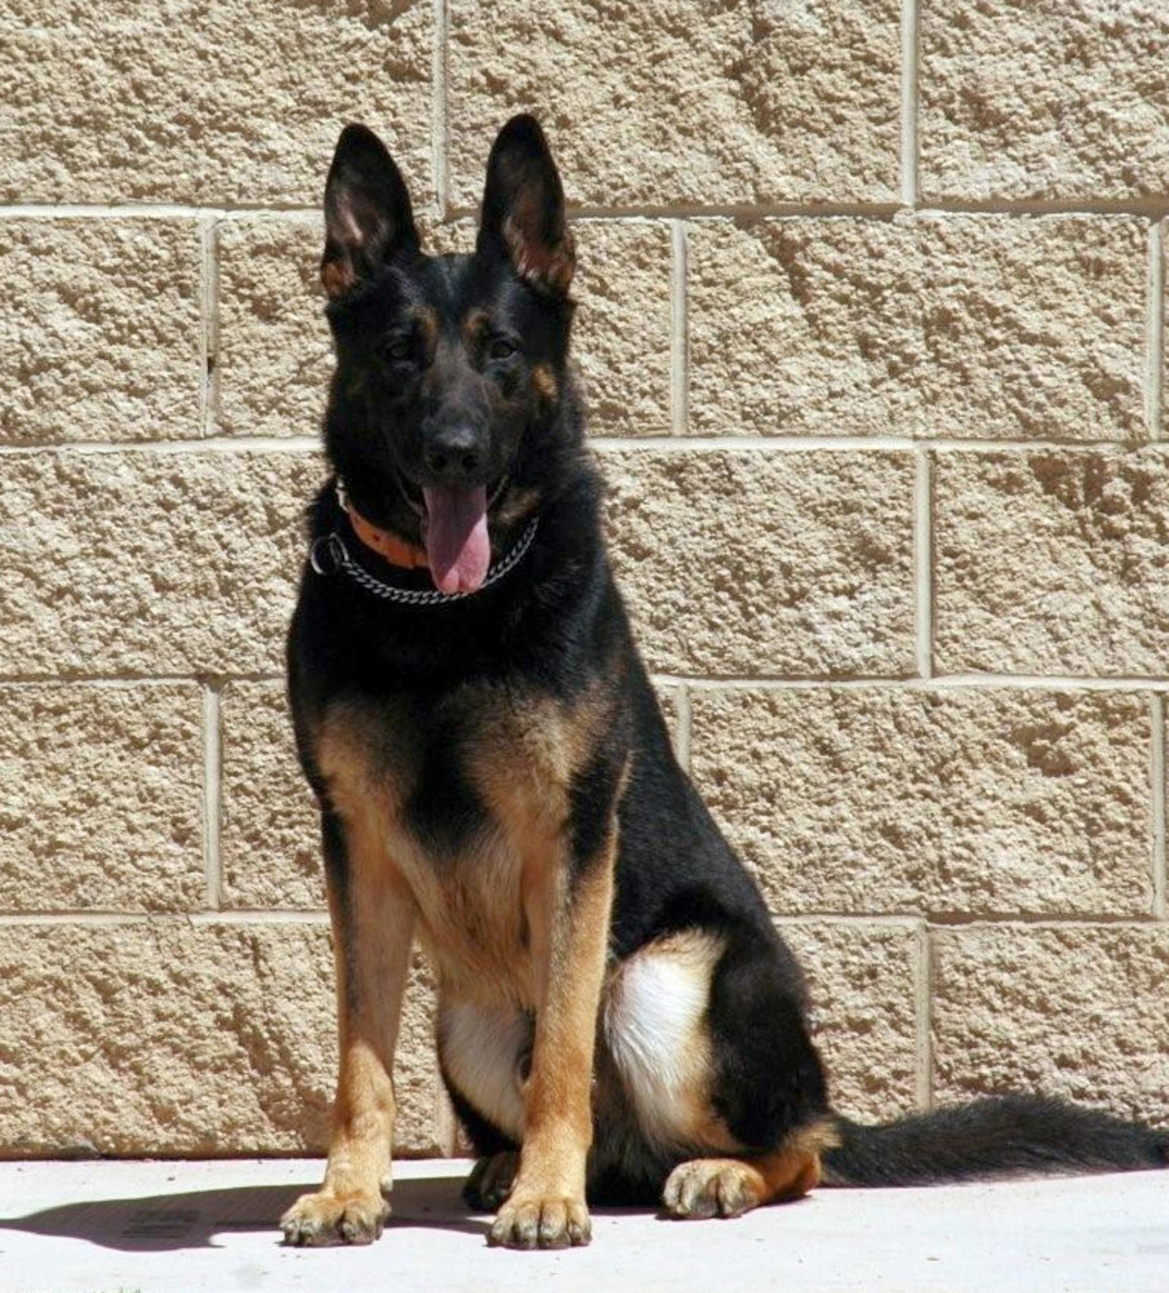
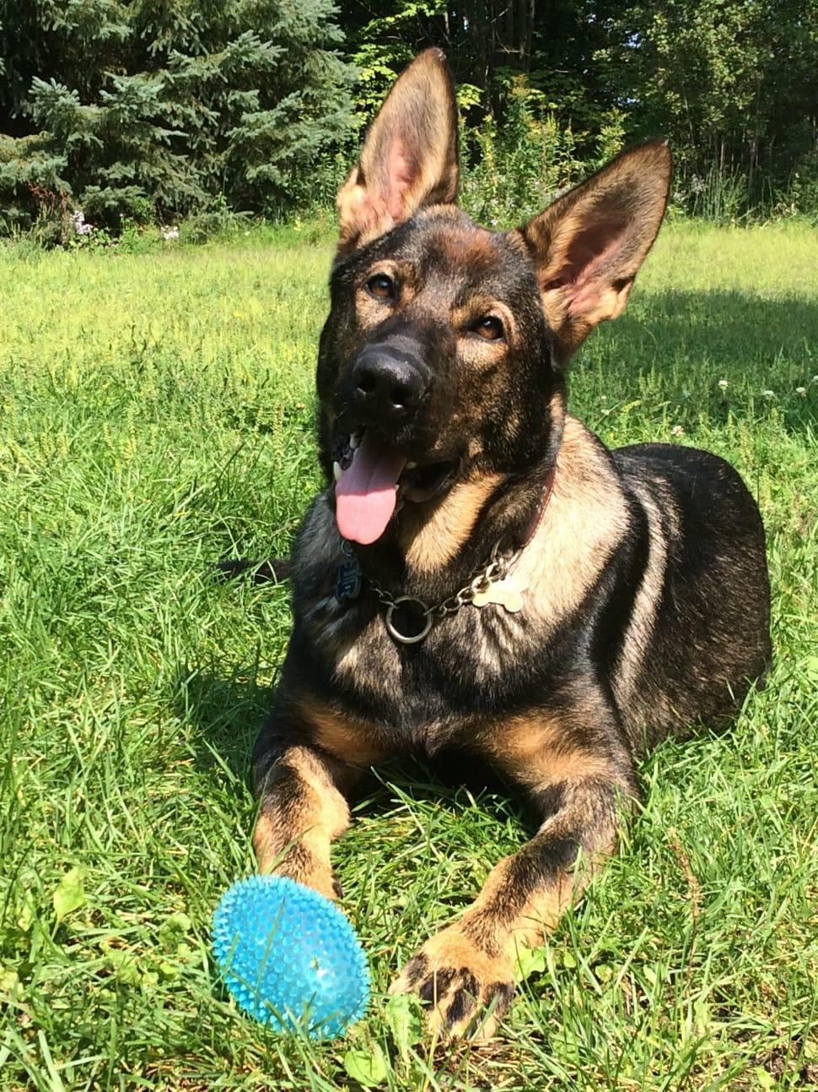
Notes:
German Shepherd

Slide 5
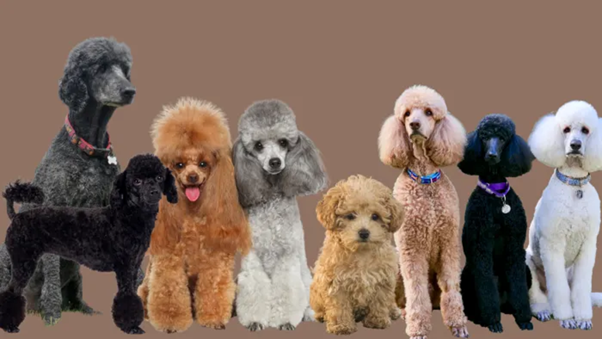
Notes:
Poodle

Slide 6
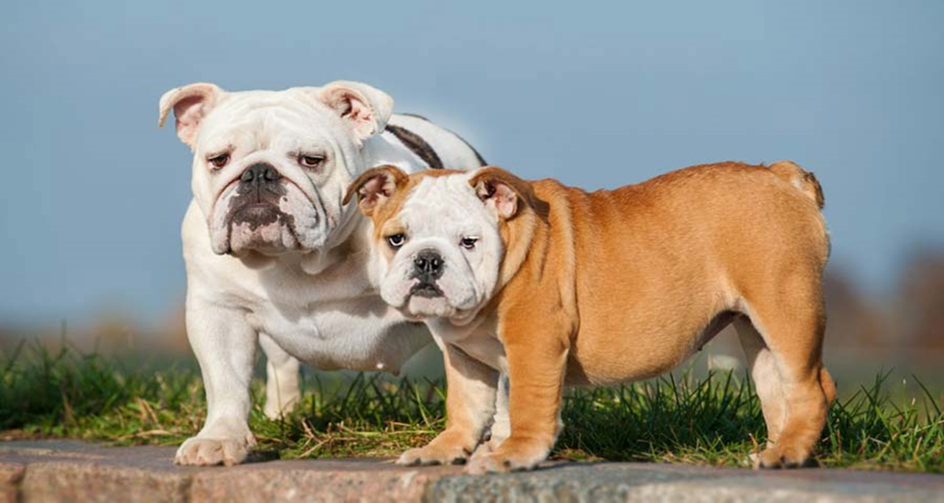
Notes:
Bulldog

Slide 7
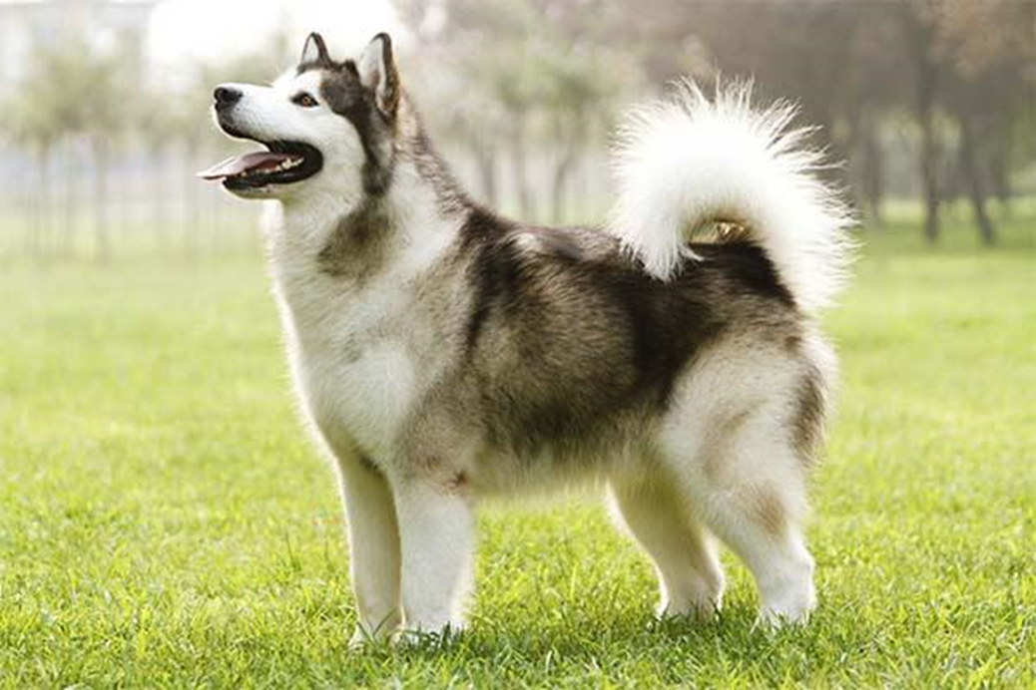
Notes:
Alaskan Malamute

Slide 8
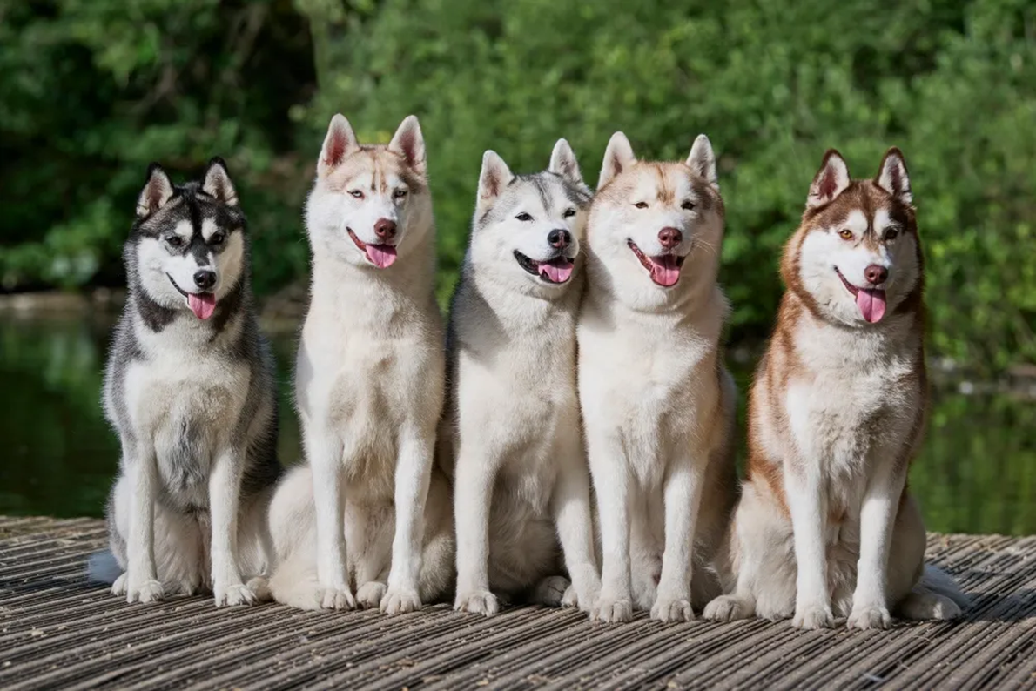
Notes:
Siberian Husky

Slide 9
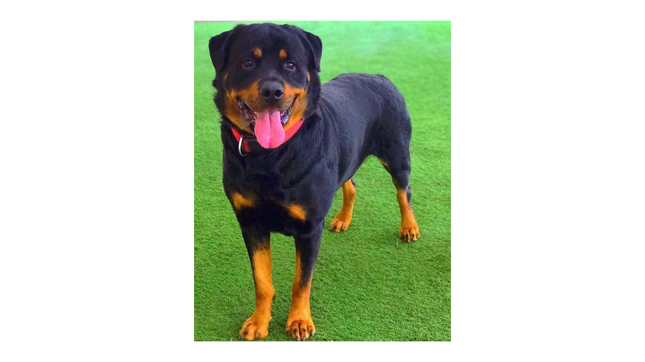
Notes:
Rottweiler

Slide 10
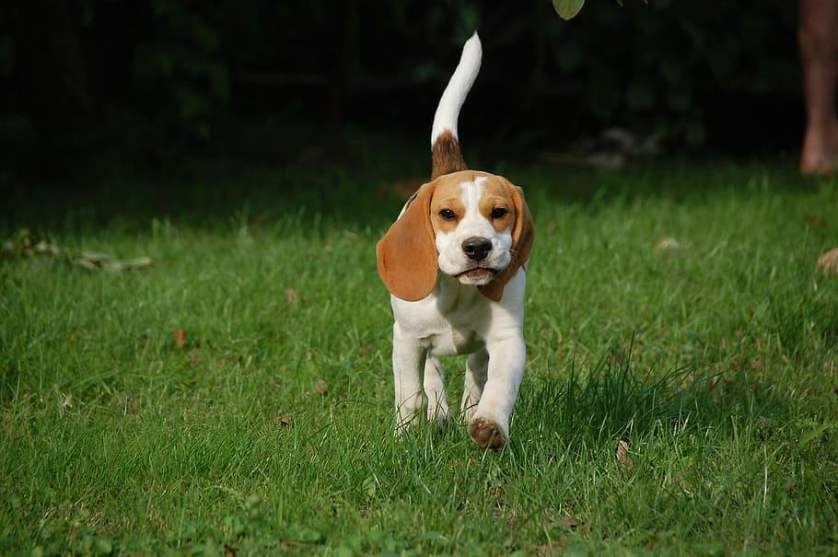
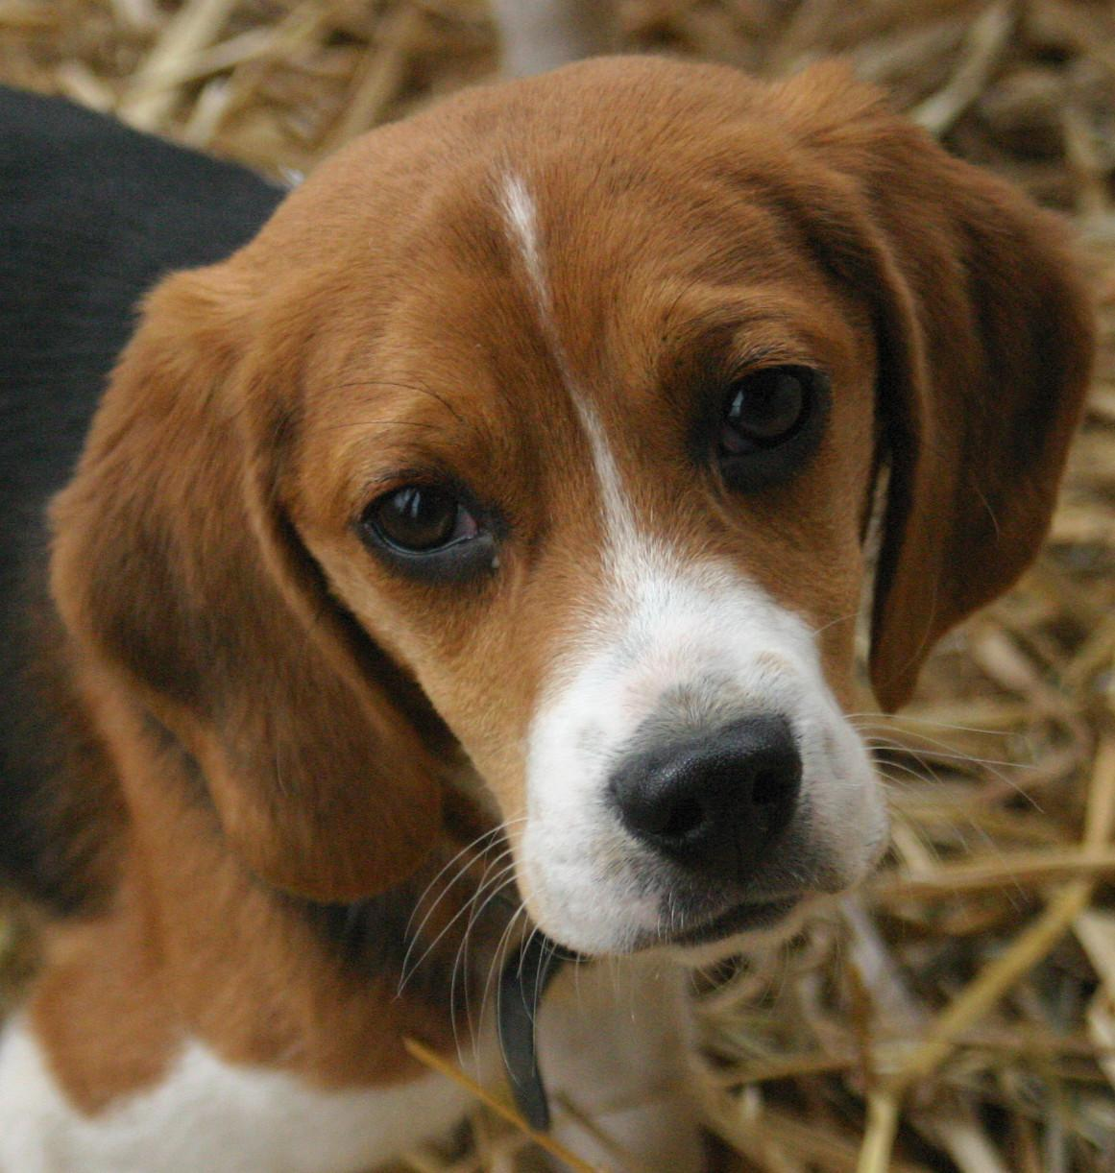
Notes:
Beagle

Slide 11
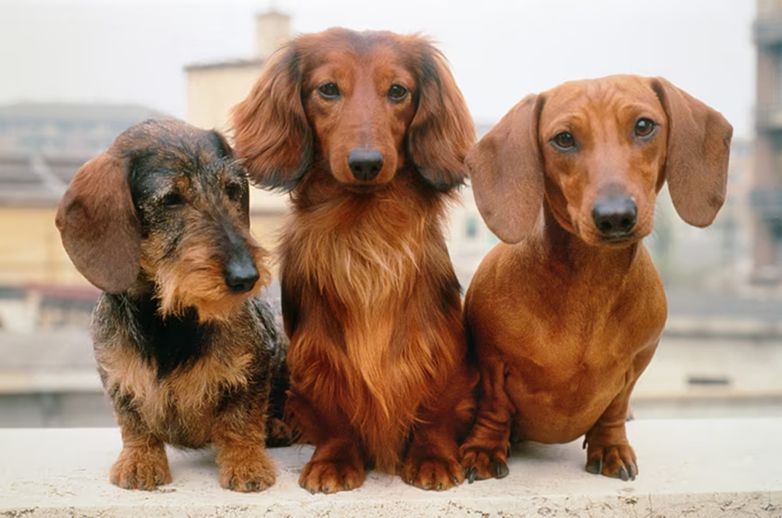
Notes:
Dachshund (Wiener Dog)

Slide 12
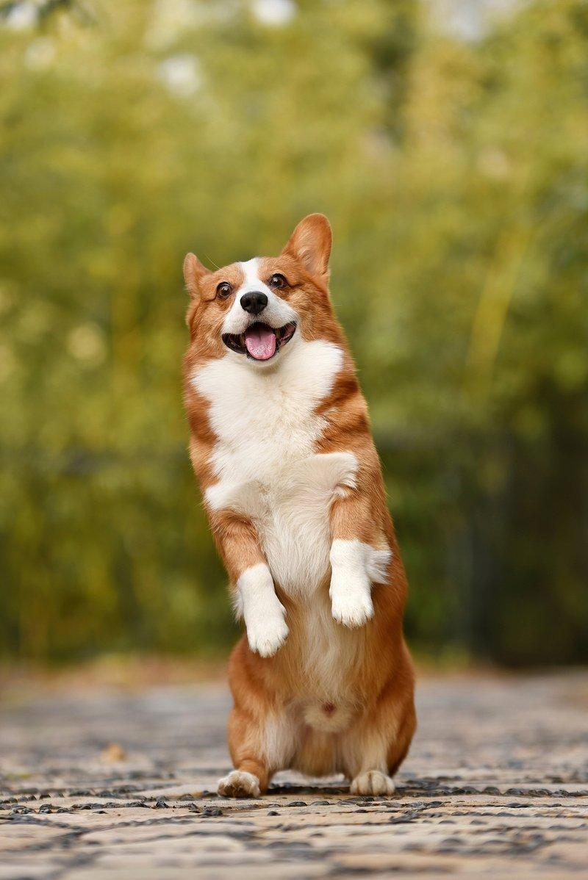
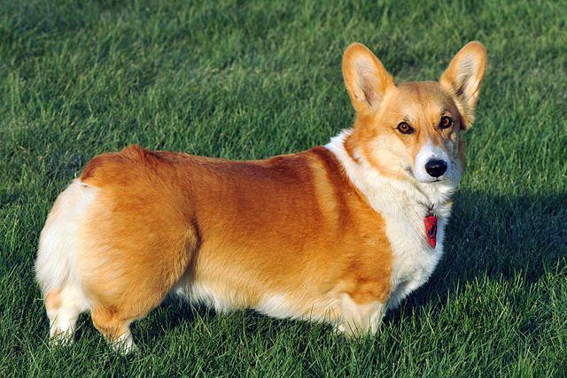
Notes:
Corgi

Slide 13
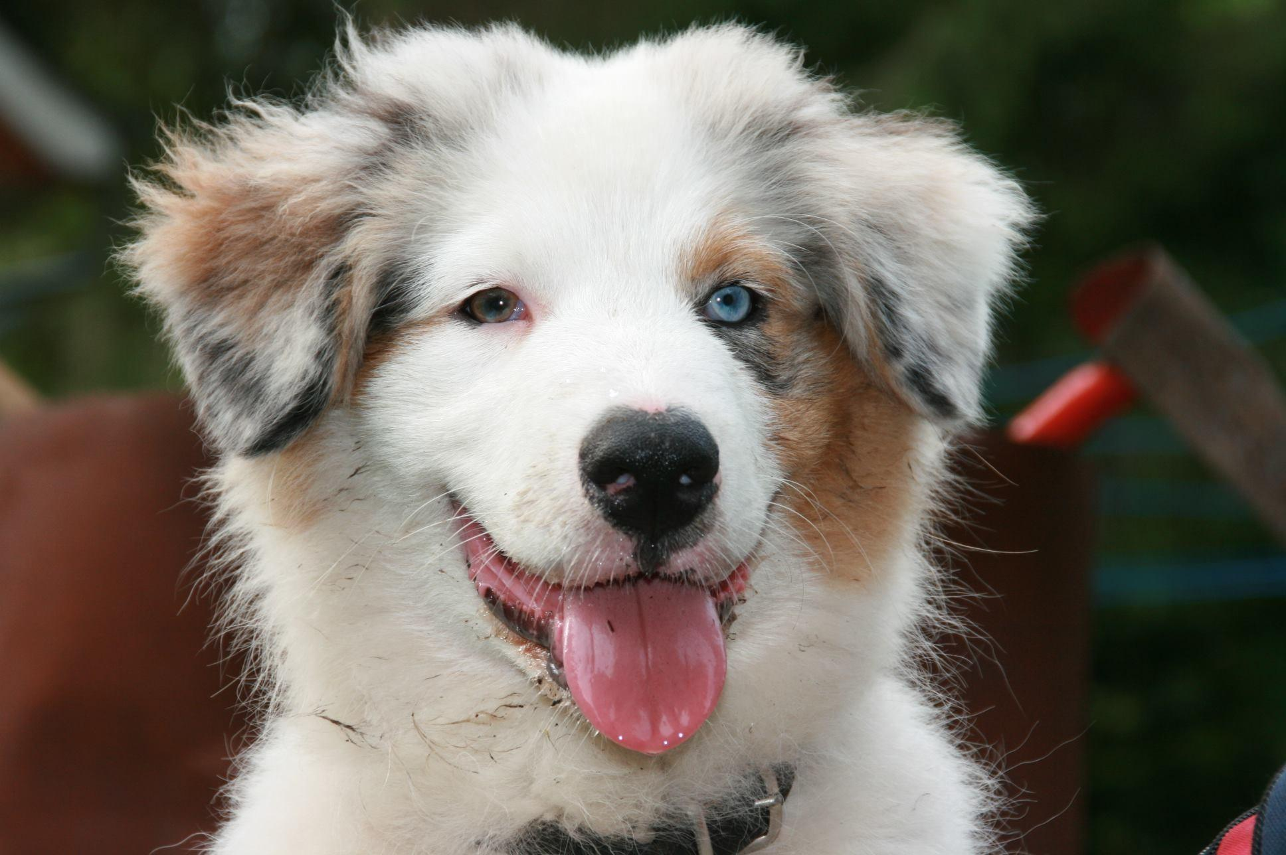
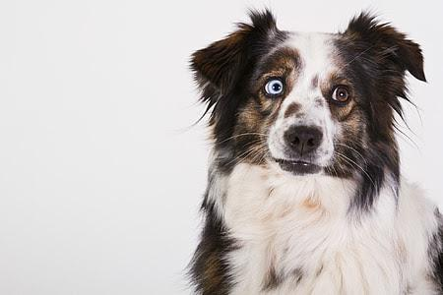
Notes:
Australian Shepherd

Slide 14
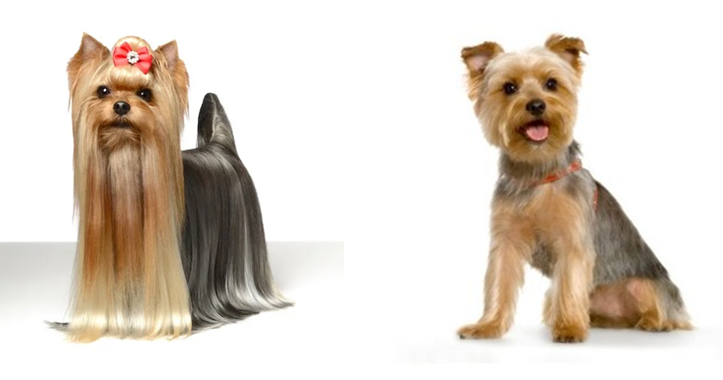
Notes:
Yorkshire Terrier

Slide 15
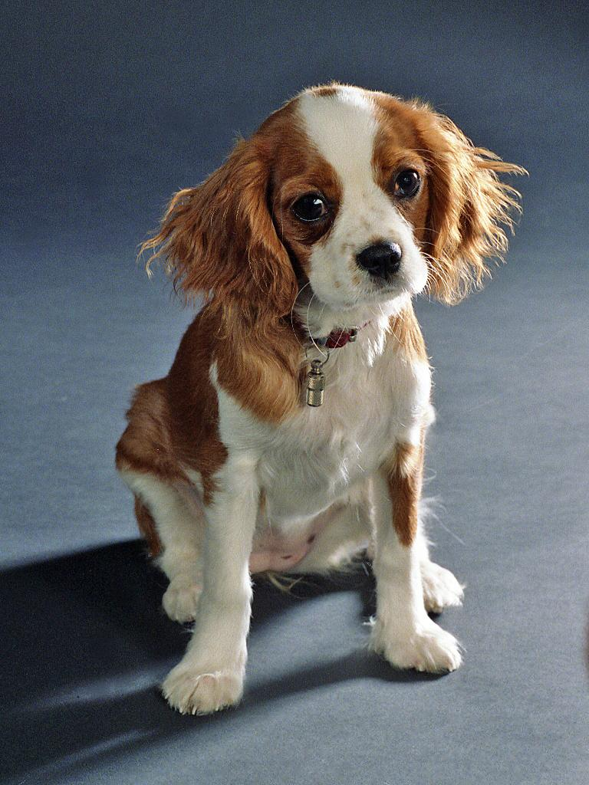
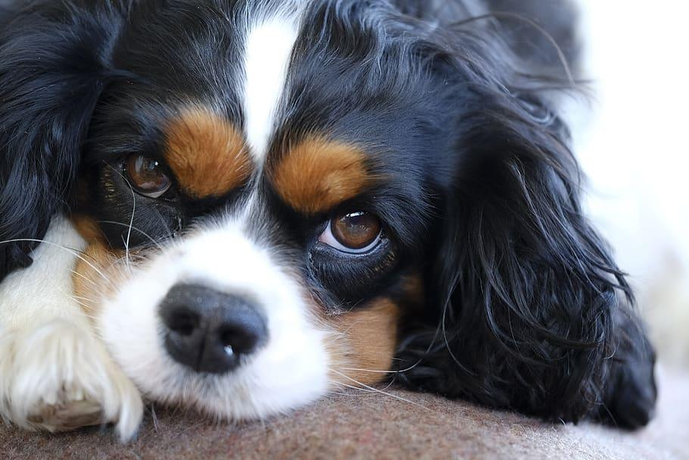
Notes:
Cavalier King Charles Spaniel

Slide 16
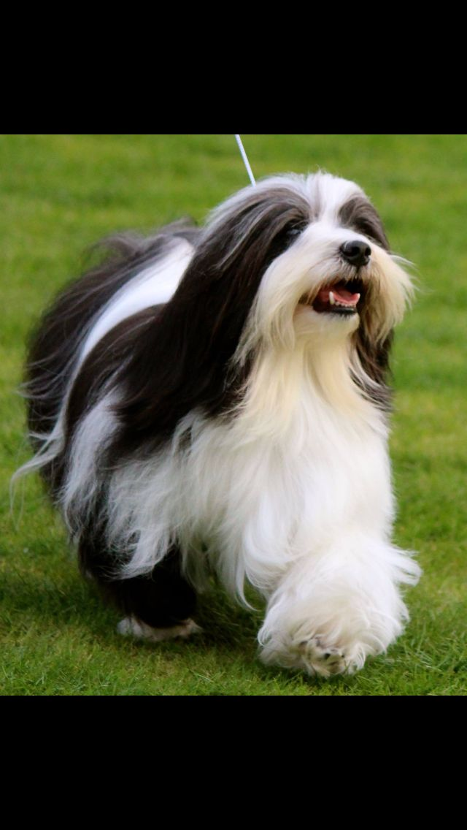
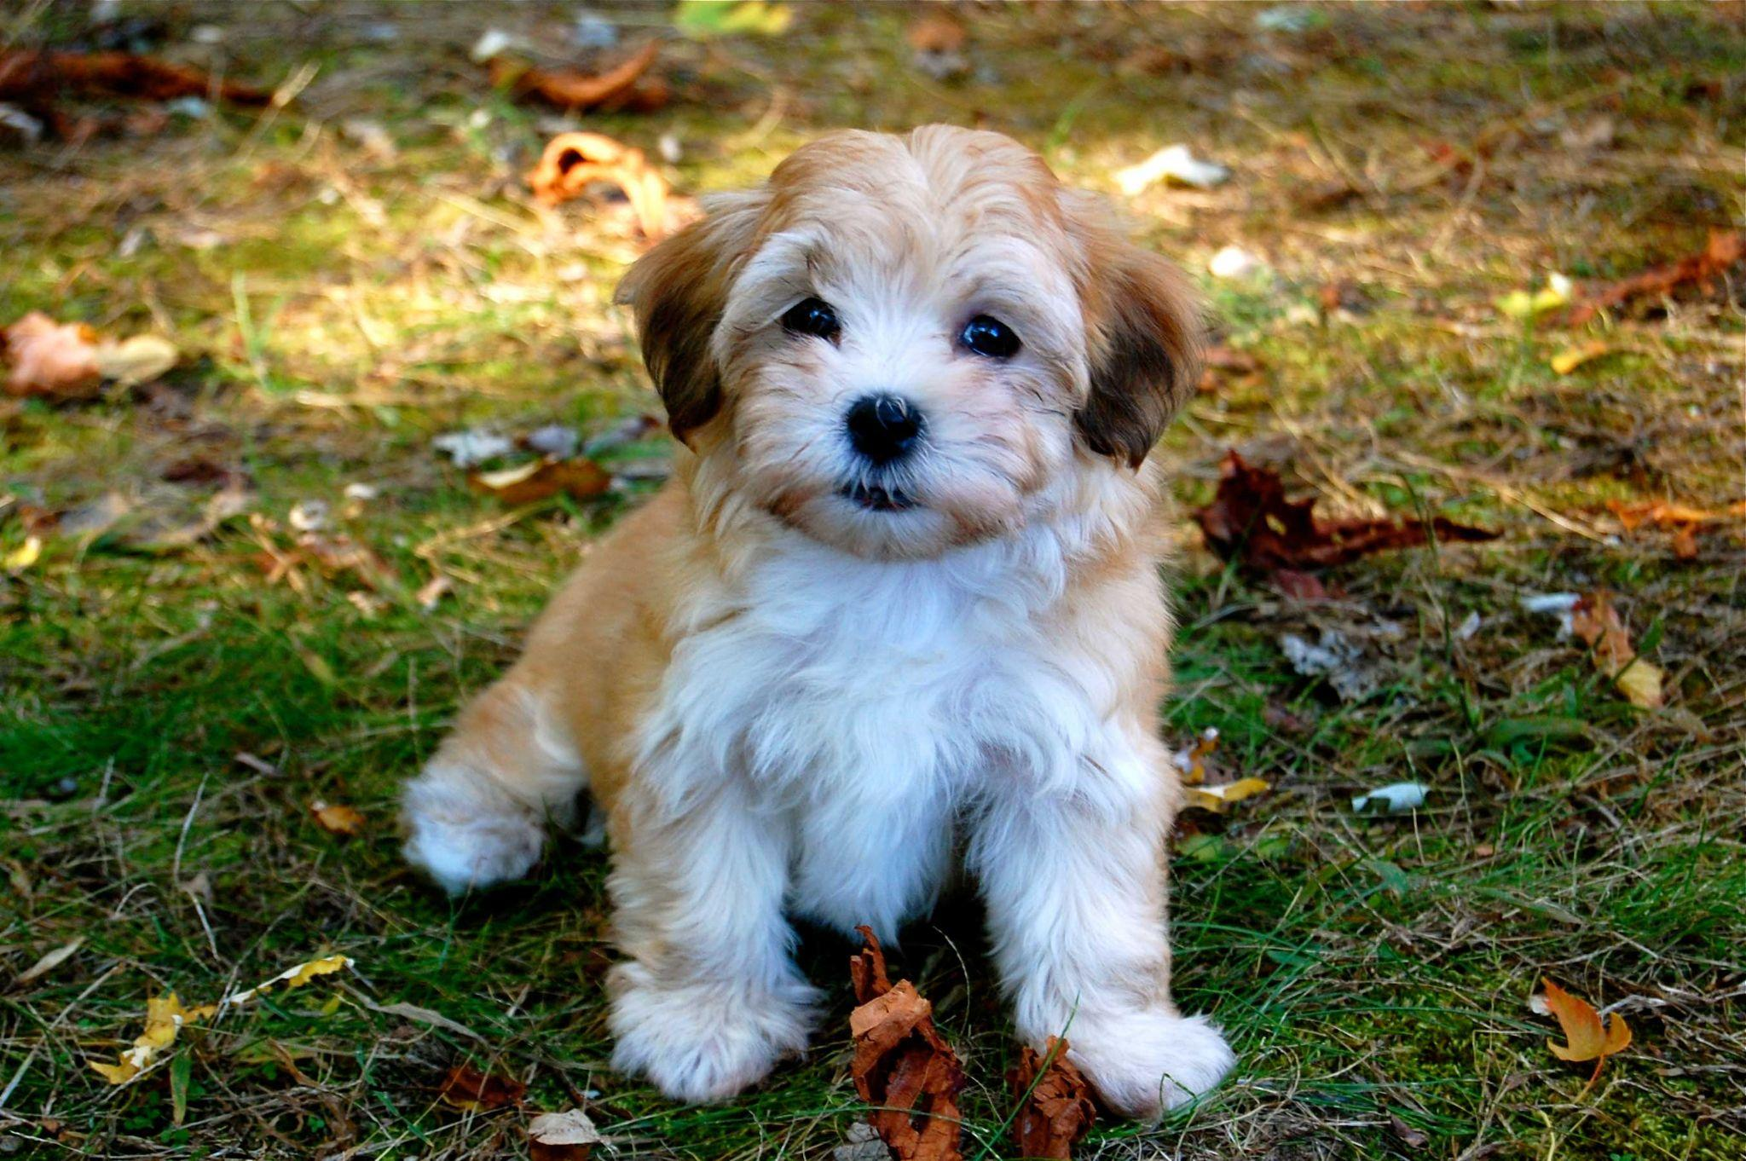
Notes:
Havanese

Slide 17
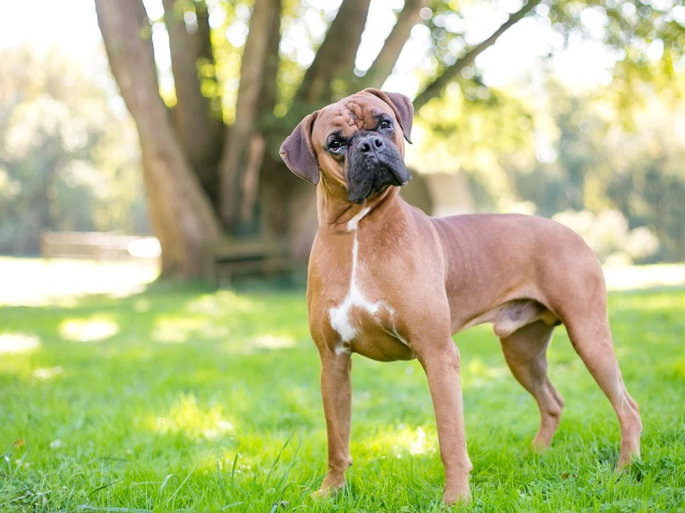
Notes:
Boxer

Slide 18
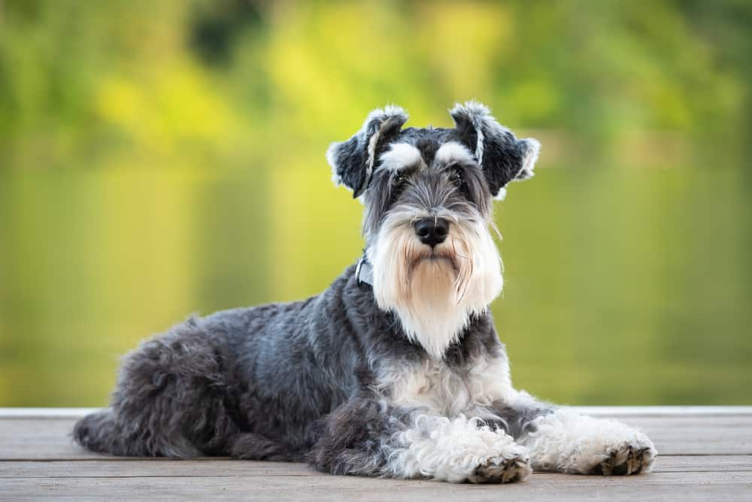
Notes:
Mini Schnauzer

Slide 19
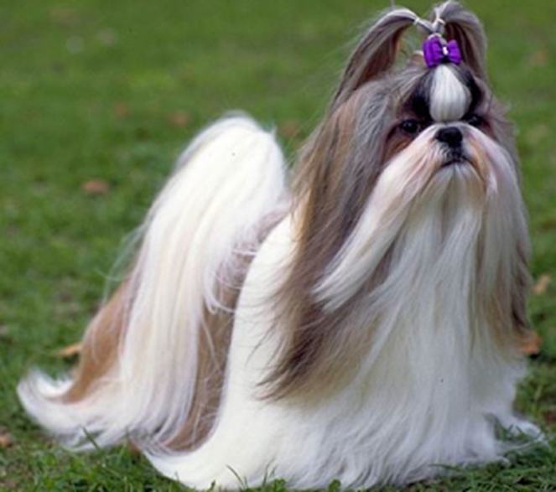
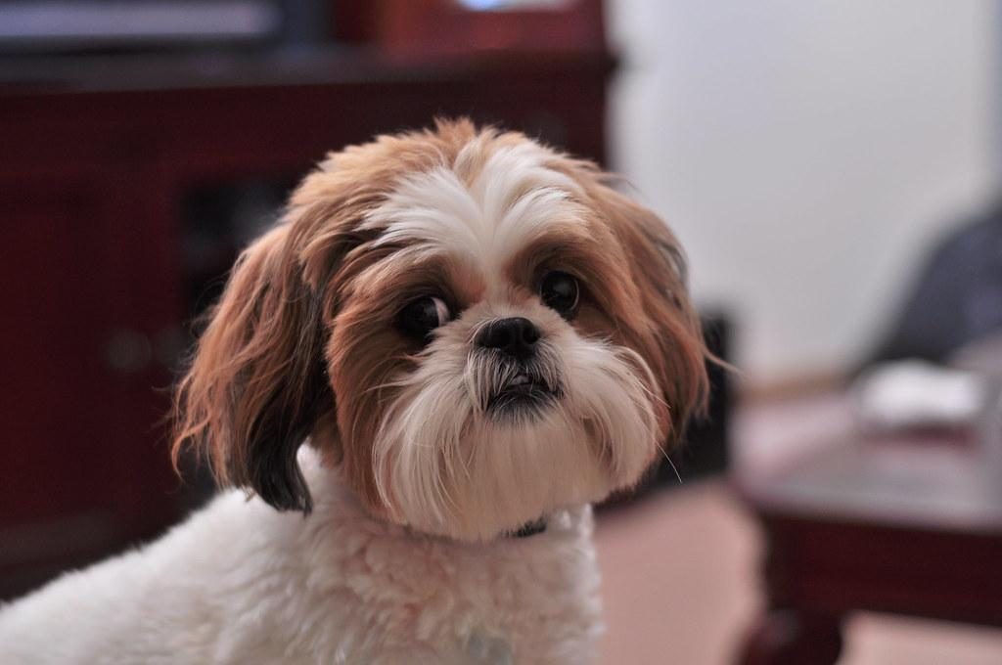
Notes:
Shih tzu

Slide 20
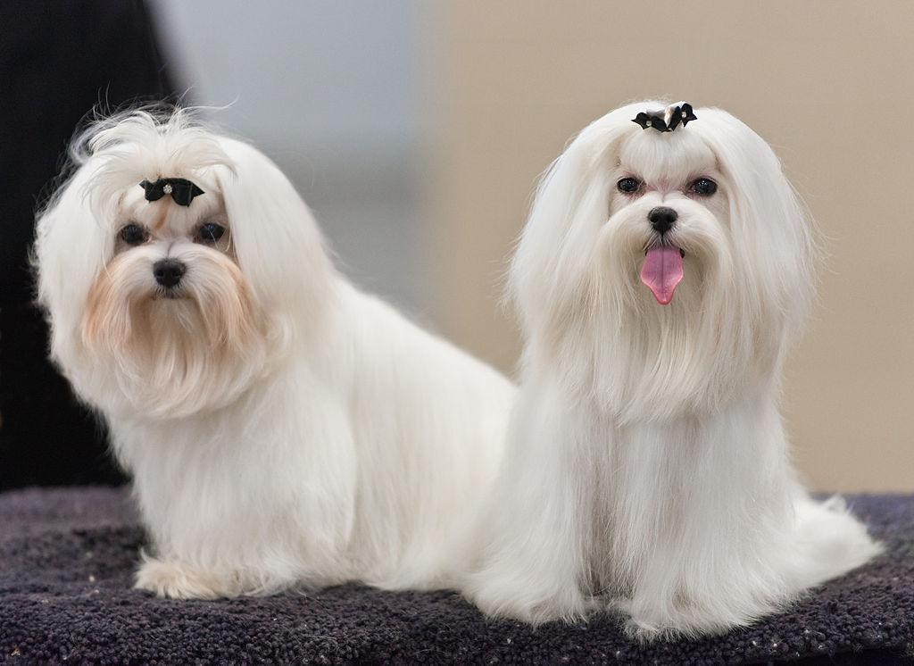
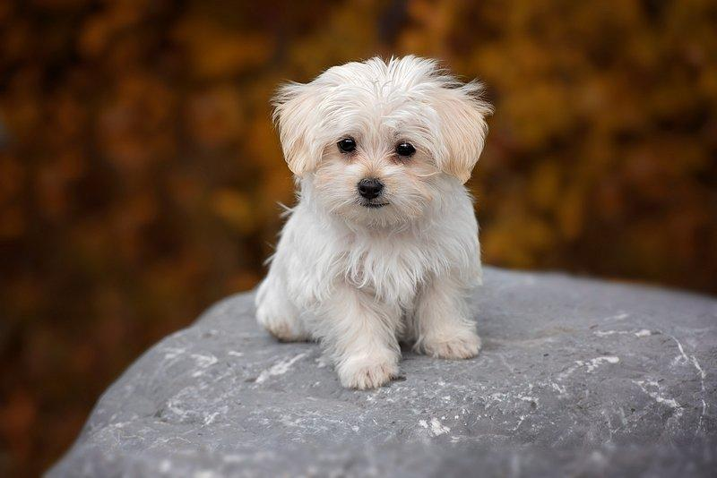
Notes:
Maltese

Slide 21
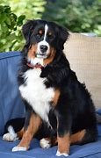
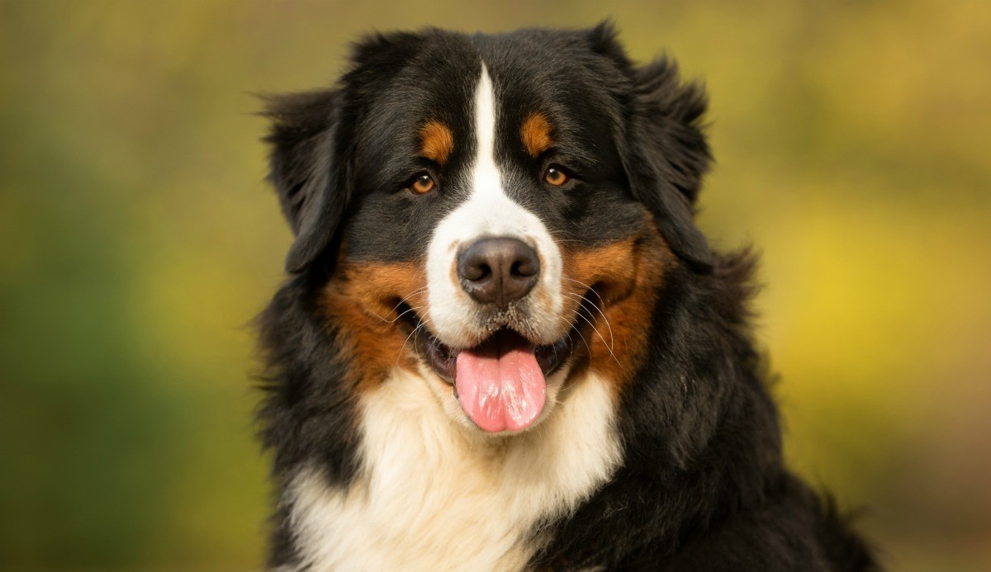
Notes:
Bernese Mountain Dog

Slide 22
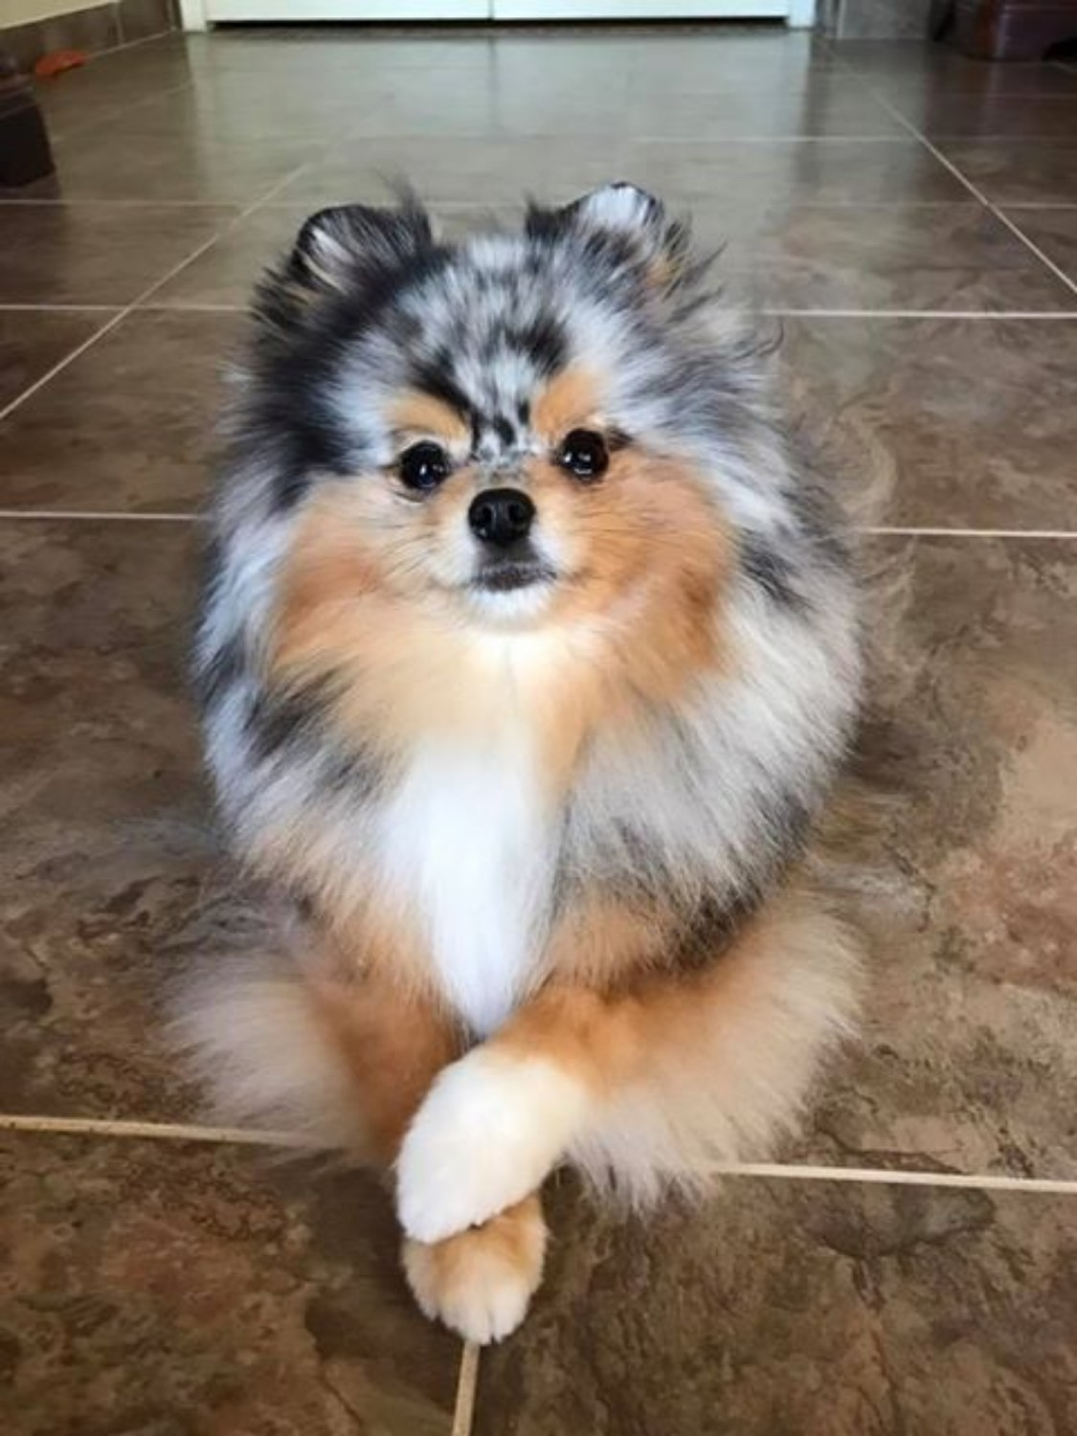
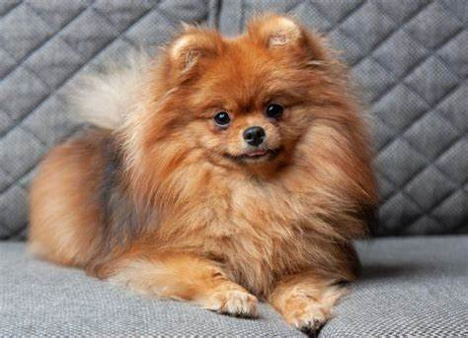
Notes:
Pomeranian

Slide 23
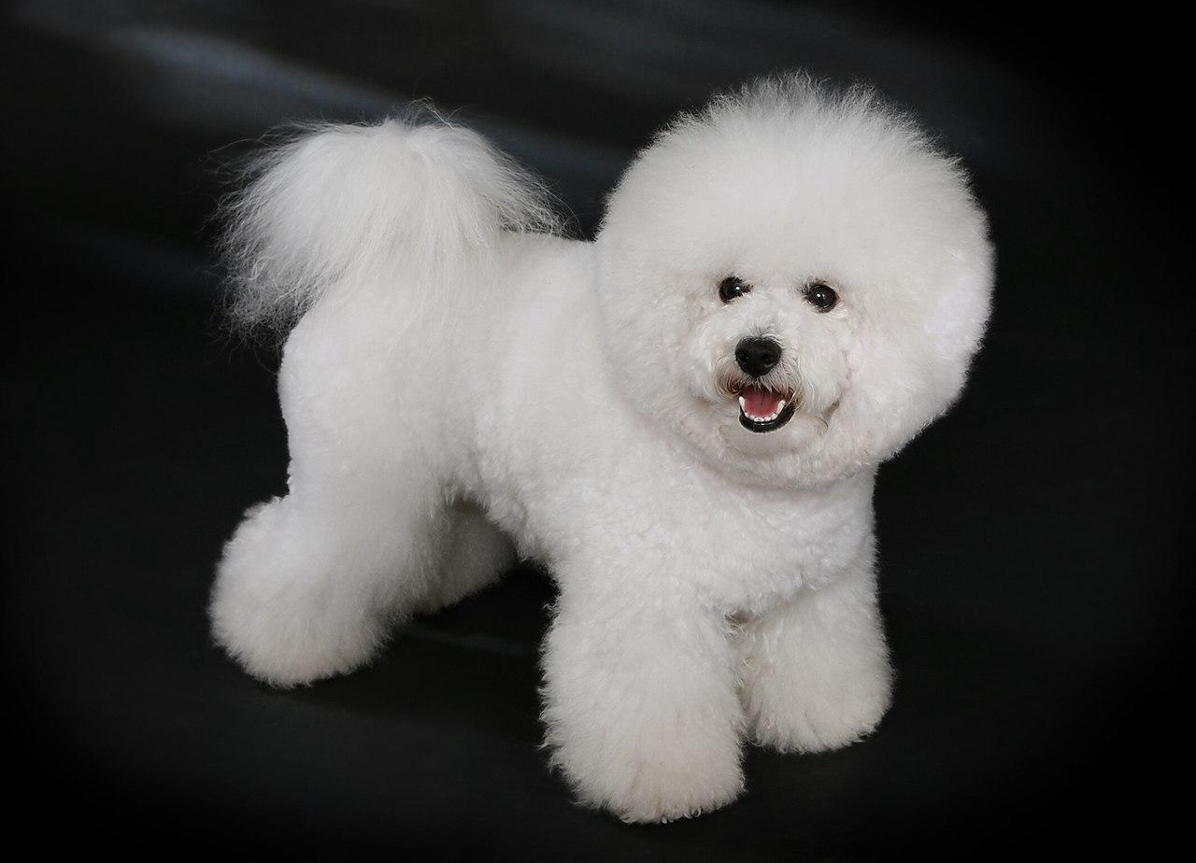
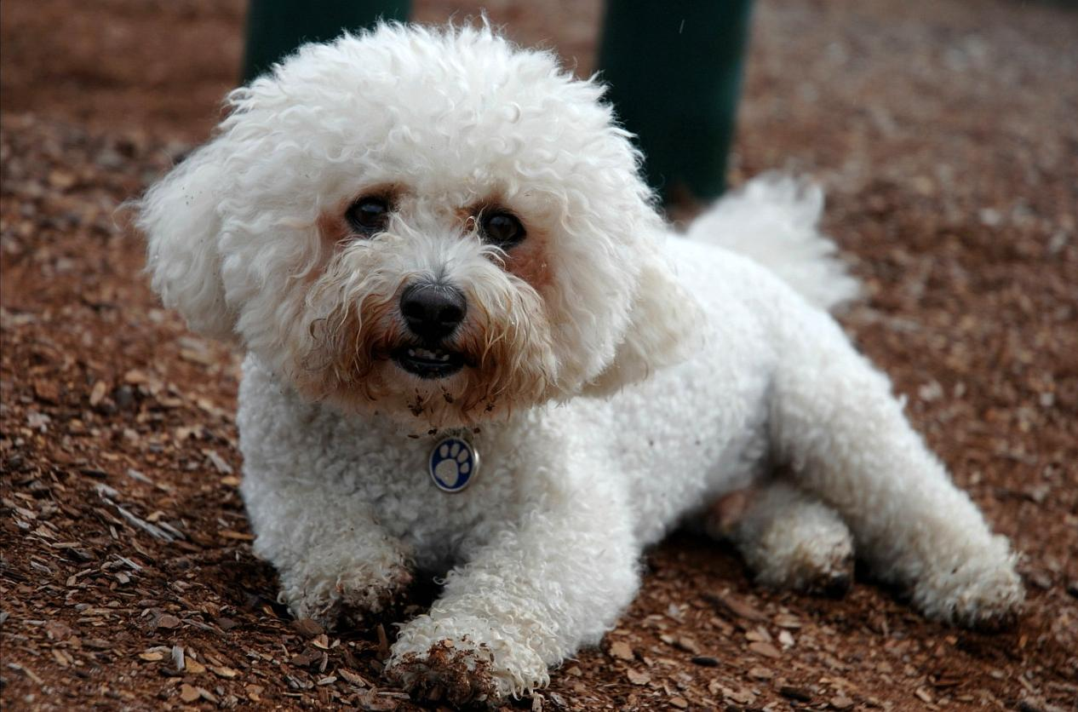
Notes:
Bichon Frise

Slide 24
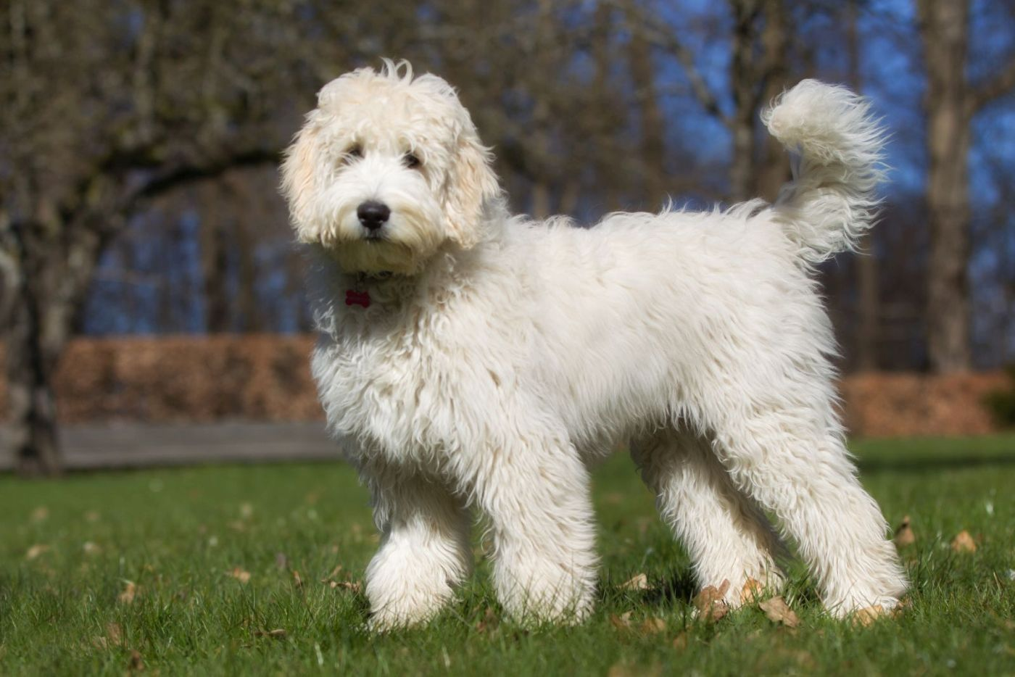
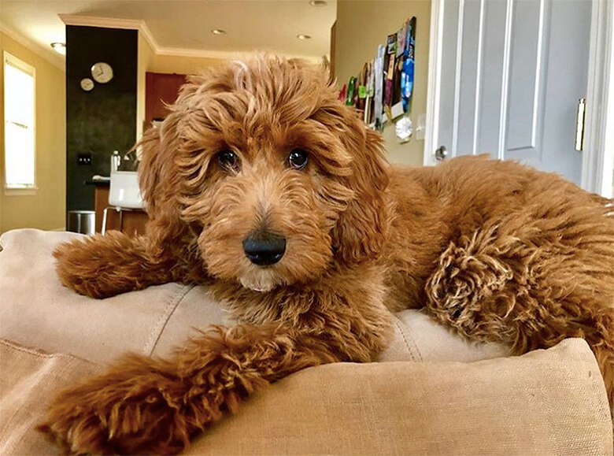
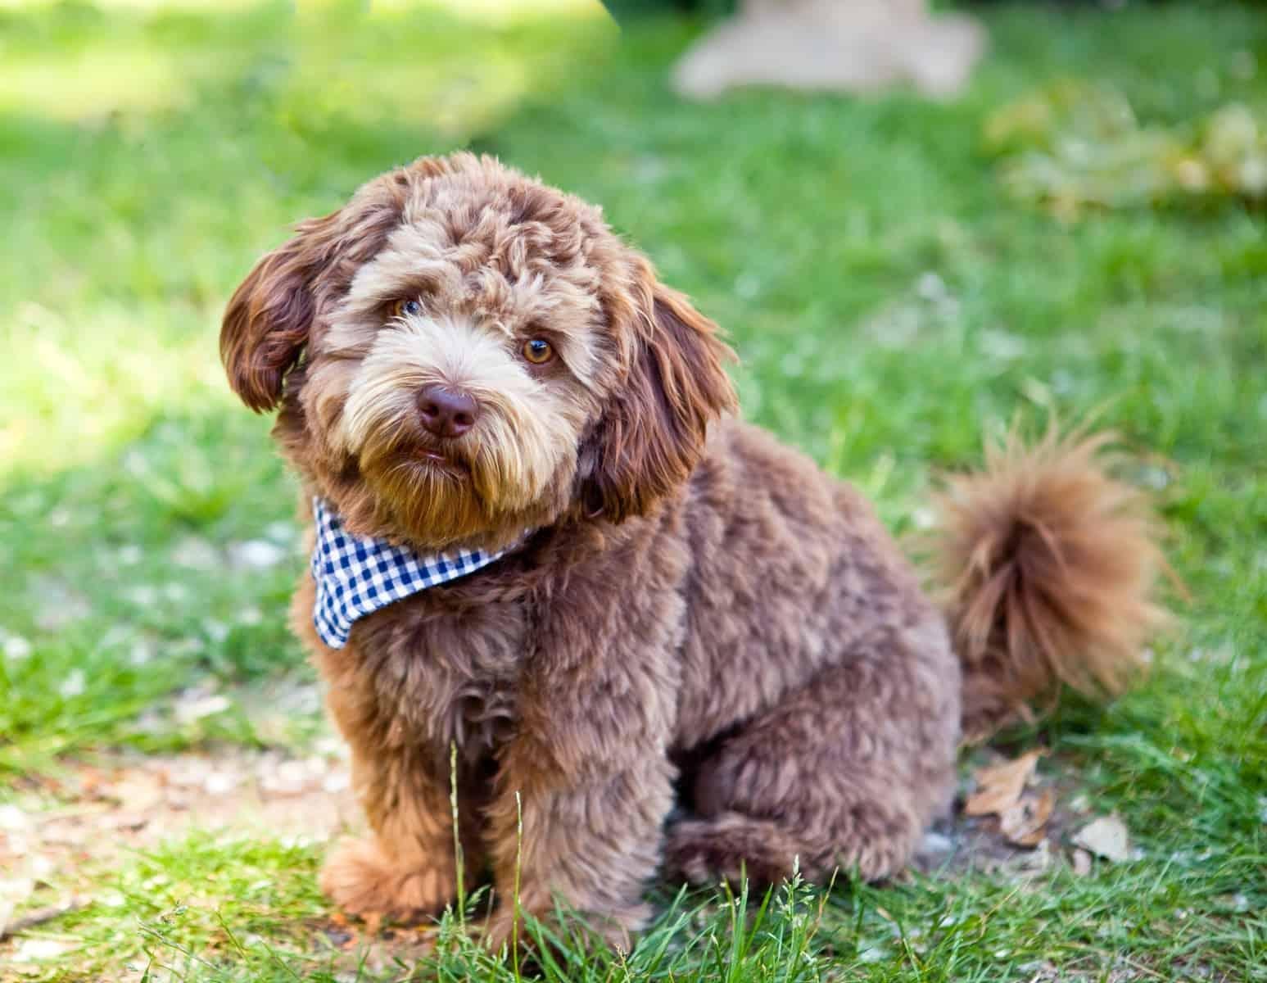
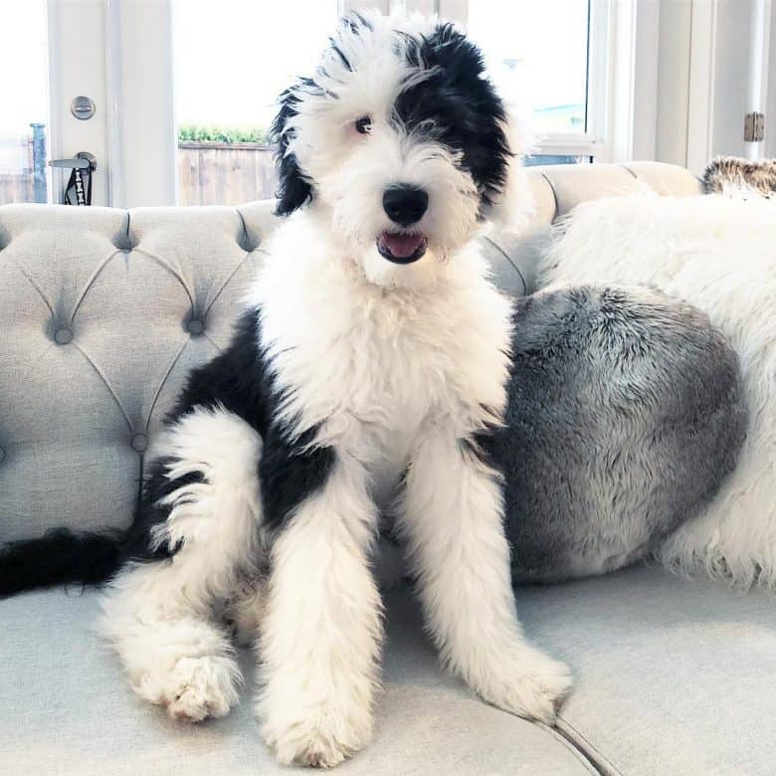
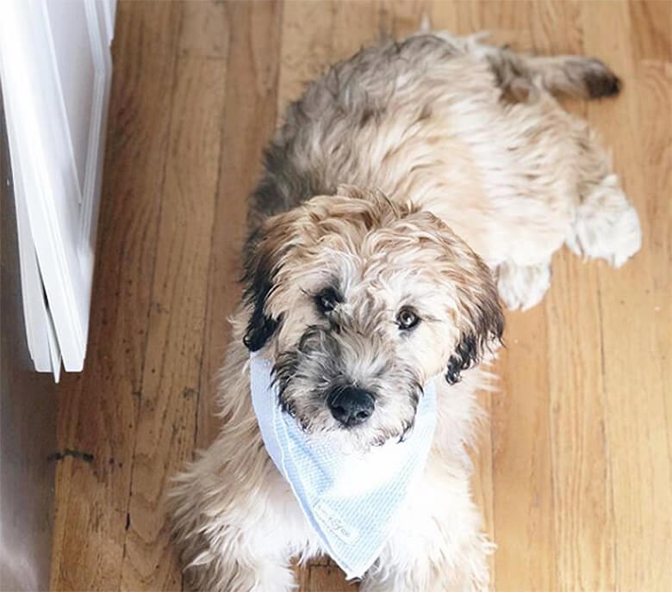
Notes:
Labradoodle
Goldendoodle
Schnoodle
Sheepadoodle
Whoodle

Slide 25
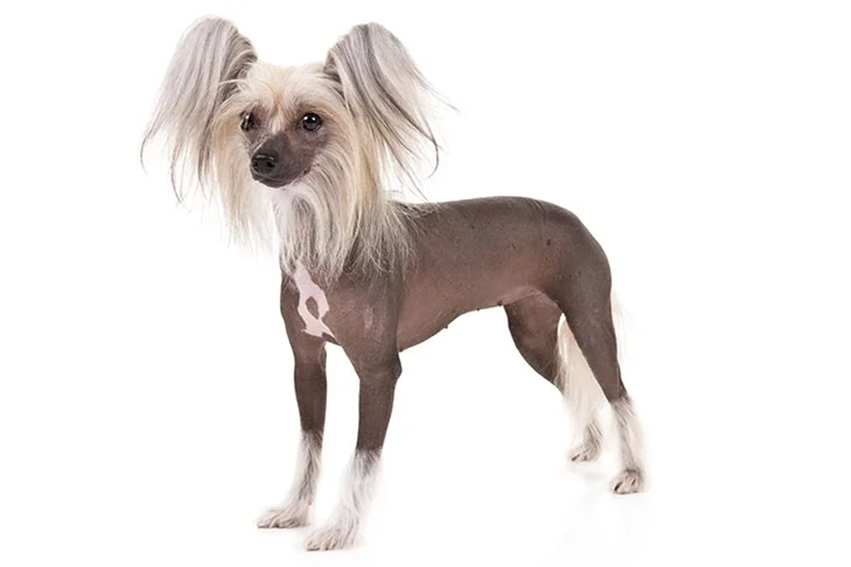
Notes:
Chinese Crested

Slide 26
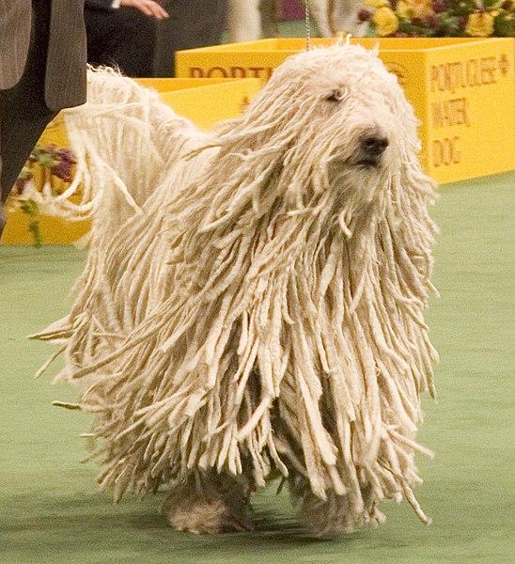
Notes:
Komodor - Corded Coat

Slide 27
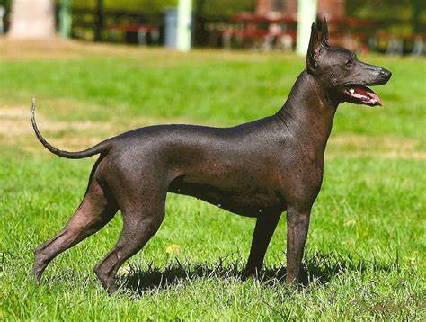
Notes:
Xoloitzcuintli Mexican Hairless
Pronunciation - Show-low

Slide 28
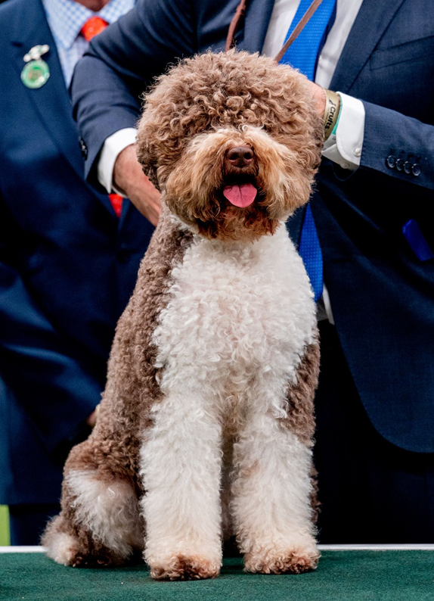
Notes:
Logatto Romagnolo

Slide 29
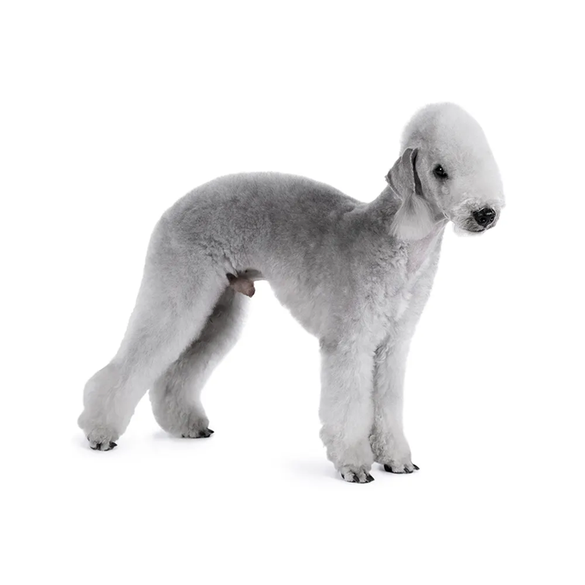
Notes:
Bedlington Terrier

Slide 30
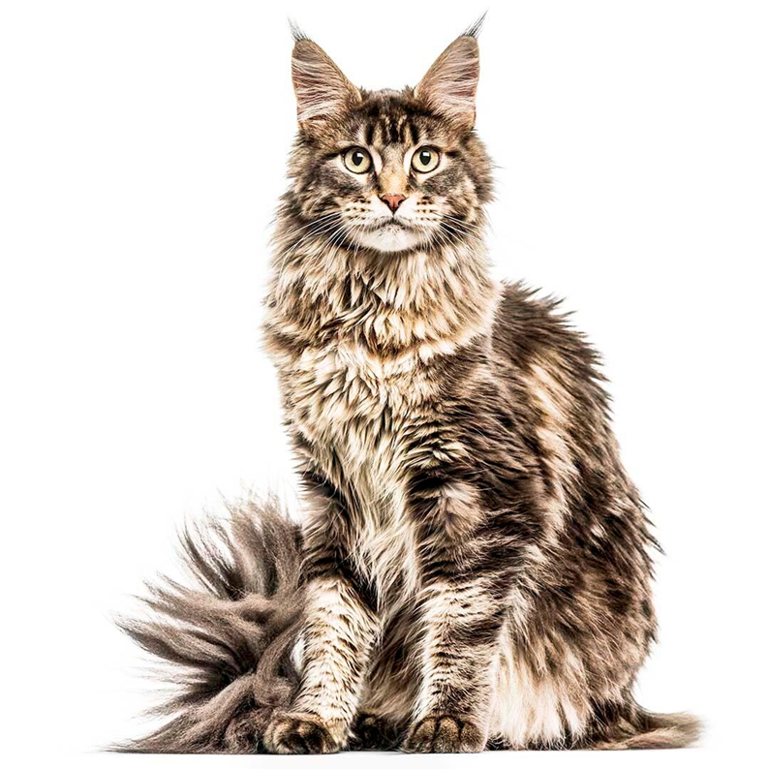
Notes:
Maincoon

Slide 31
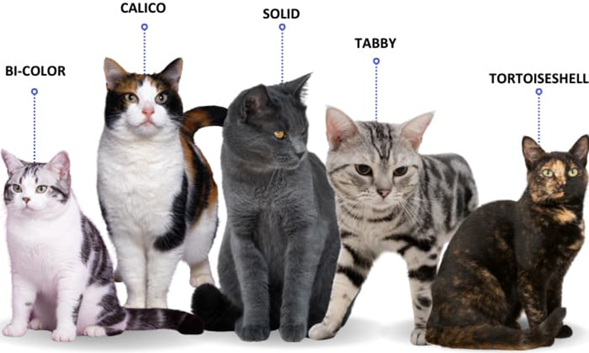
Notes:
Domestic Short Hair

Slide 32
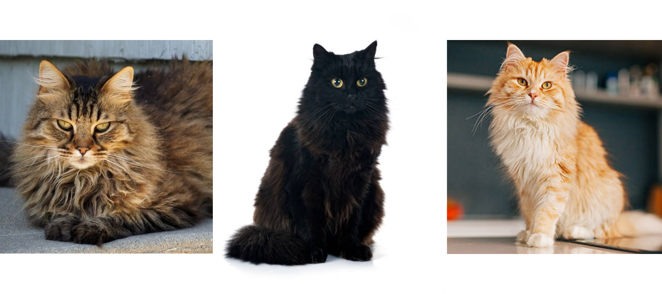
Notes:
Domestic Long Hair

Slide 33
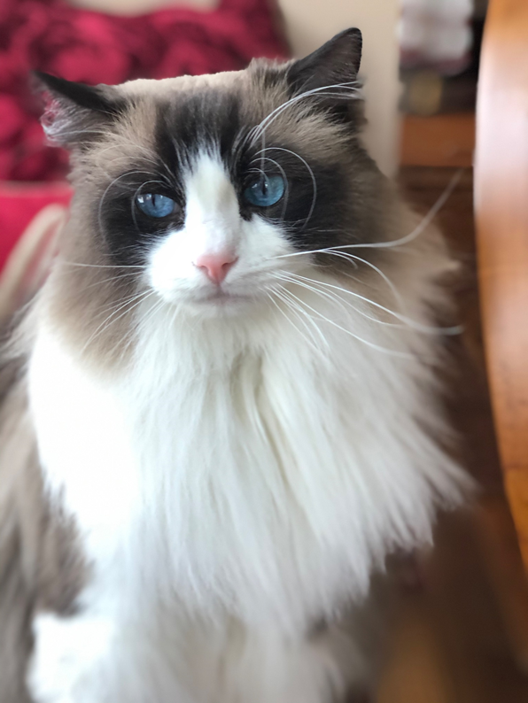
Notes:
Ragdoll

Slide 34
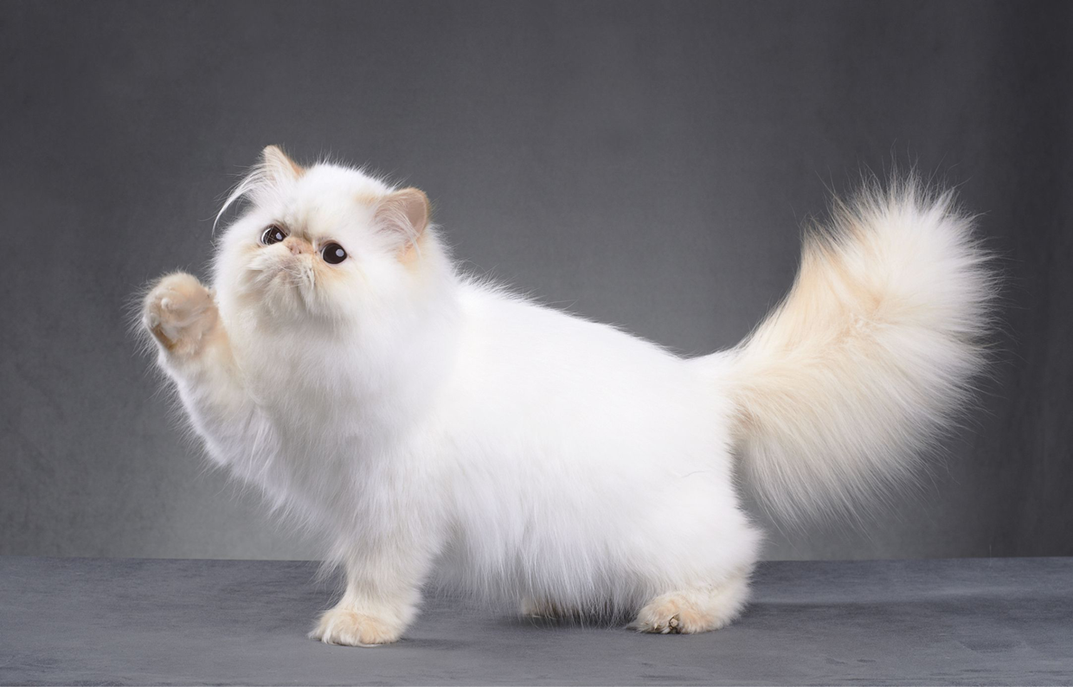
Notes:
Persian Cat

Slide 35
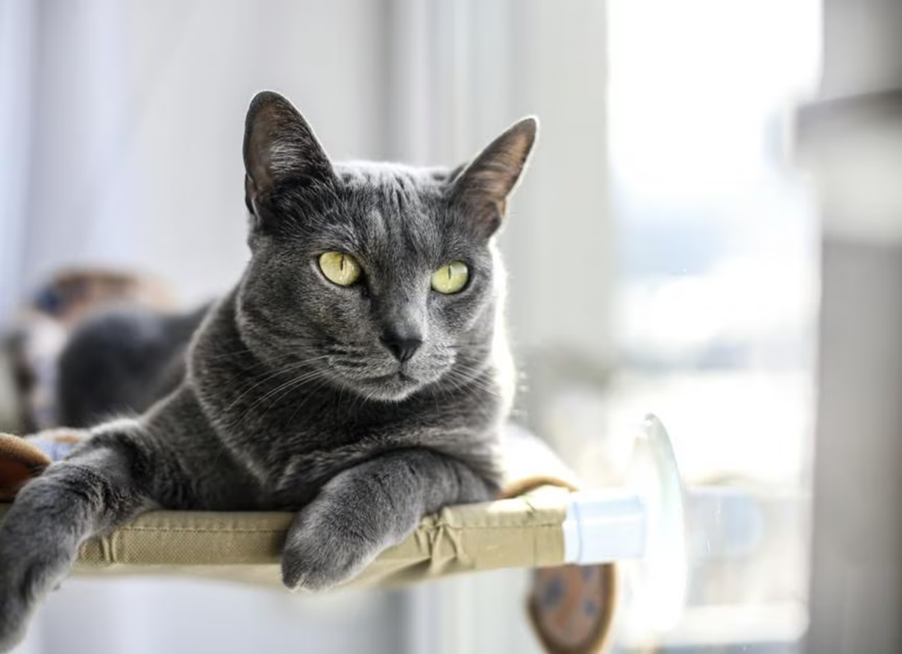
Notes:
Russian Blue

Slide 36
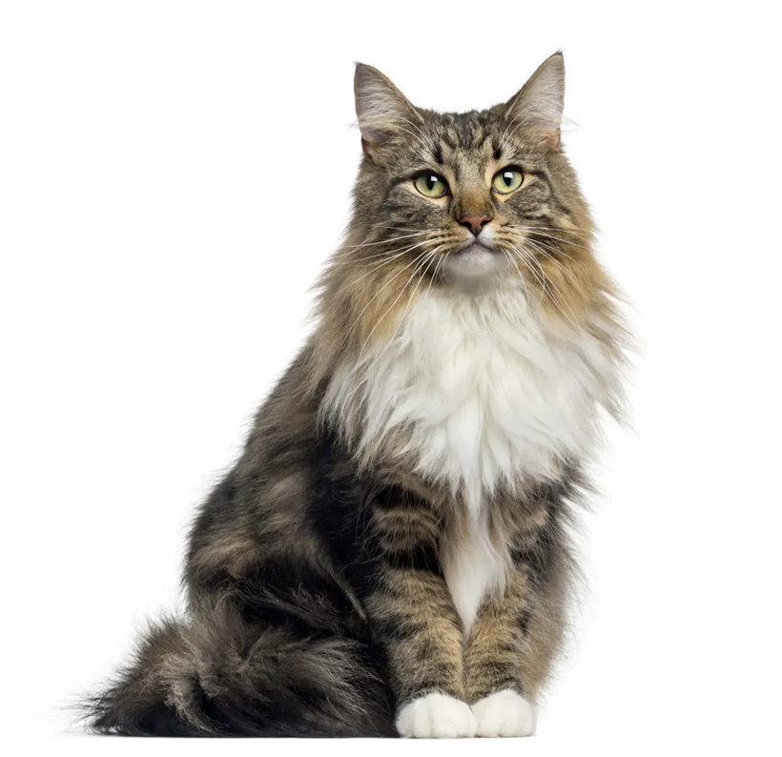
Notes:
Norwegian Forest Cat

Slide 37
Notes:
Bengal

Slide 38
Notes:
Scottish Fold
Ear Tufts

Slide 39
Notes:
Sphinx Cat
SLIDES 15-55 1 HOUR AND 15 MINUTES

